Slide 1

Co-cooning
Personalized Movie and Series Recommendations
Foteini Iliadou
Notes:
This presentation was automatically generated by PowerPoint Copilot based on content found in this document: https://bewisegr-my.sharepoint.com/personal/f_iliadou_bewise_gr/_layouts/15/Doc.aspx?sourcedoc=%7B9EF51A46-D1F1-4D85-86AB-CF57E74AF3BC%7D&file=co-cooning.docx&action=default&mobileredirect=true&DefaultItemOpen=1 AI-generated content may be incorrect.

Slide 2
Agenda
Introduction
Domain and Features
Installation Guide
User Scenarios
Functionality
Forms
Policies
Test Cases
Challenges and Real World Data
Further Steps
Sources
Notes:
Agenda * Introduction * Description of Co-cooning * Motivation for Developing Co-cooning * Domain and Features * Domain of Co-cooning * Features * Installation Guide * User Scenarios * Sad Path with Rage * Sad Path with Movie Recommendation * Sad Path with Series Recommendation * Movie Recommendation Path * Functionality * Greeting the User * Movie Recommendation Details * Series Recommendation Details * Challenge with Rage * Challenge with Movie Recommendation * Challenge with Series Recommendation * Saying Goodbye * Forms * Policies * RulePolicy * MemoizationPolicy * Test Cases * Movies Scenario * Series Scenario * Challenge Scenario * Movies Scenario with Challenge * Series Scenario with Challenge * Challenges and Real World Data * Development Challenges * Real World Data Sources * Further Steps * Sources

Slide 3

Description of Co-cooning
Purpose of Co-cooning Model
Assists users in selecting movies or series based on preferences
Simplifies decision-making process
Personalized Recommendations
Offers a wide range of options
Encourages users to unwind and enjoy
Meaning of 'Co-cooning'
Reflects its role as a companion
Helps users embrace the comfort of cocooning
Notes:
The Co-cooning model helps users select movies or series based on their preferences, simplifying decision-making. It offers personalized recommendations, encouraging relaxation. The name 'Co-cooning' reflects its role as a companion in creating a cozy, stress-free viewing experience. Original Content: Description of Co – cooning The Co-cooning model is designed to assist users in selecting movies or series based on their preferences, simplifying the often difficult decision-making process. By offering personalized recommendations from a wide range of options, it encourages users to unwind and enjoy a relaxed viewing experience. The name "Co-cooning" reflects its role as a companion in helping users embrace the comfort of cocooning—settling in for a cozy, stress-free movie or series session.

Slide 4
Motivation for Developing Co-cooning
Overwhelming Streaming Choices
Endless streaming options make choosing what to watch difficult
Hours wasted on trailers and plot summaries
Frustration and Stress
Delays downtime
Adds stress to a relaxing experience
Personalized Recommendation System
Simplifies decision-making process
Saves time
Focuses on enjoying leisure time
Versatile Use
Notes:
Choosing what to watch can be overwhelming with endless streaming options. Co-cooning aims to eliminate this frustration by using a personalized recommendation system, simplifying decision-making, saving time, and making leisure time enjoyable, whether for solo or group viewing. Original Content: Motivation for Developing Co-cooning Choosing what to watch has become an overwhelming task in today's world of endless streaming options. Often, we find ourselves wasting hours watching trailers, reading plot summaries, and still feeling unsure about what will truly suit our mood or preferences. This not only delays our downtime but also adds stress to what should be a relaxing experience. The motivation behind developing Co-cooning was to eliminate this frustration. By using a personalized recommendation system, I aimed to create a tool that simplifies the decision-making process, saving time and helping users focus on enjoying their leisure time. Whether it's for a cozy solo night in or a fun group viewing, Co-cooning acts as a trusted partner in finding the perfect movie or series, making cocooning a stress-free, enjoyable experience.

Slide 5

Domain of Co-cooning
Focus on Personalized Recommendations
Asks if the user wants to watch a movie or series
Inquires about preferred genre and release year
Utilizes User Preferences
Narrows down options based on inputs
Provides tailored suggestions
Notes:
The Co-cooning domain specializes in recommending movies and series. It asks users if they prefer movies or series, their favorite genres, and release years. Based on these inputs, it offers personalized recommendations. Original Content: Domain of Co-cooning The domain of Co-cooning focuses on movie and series recommendation. It asks whether the user wants to watch a movie or series, along with their preferred genre and release year. With these inputs, the bot narrows down options to provide personalized recommendations that suit the user's preferences.

Slide 6

Features
Easy-to-Use Interface
Simplifies the process of selecting movies or series
Customized Suggestions
Based on user input
Focuses on genre and release year
Streamlined Decision-Making
Helps users quickly find something to watch
Reduces time spent searching
Maximizes relaxation
Notes:
Co-cooning offers an easy-to-use interface that simplifies movie or series selection. It provides customized suggestions based on genre and release year, helping users quickly find something to watch and maximizing relaxation. Original Content: Features Co-cooning offers an easy-to-use interface that simplifies the process of selecting movies or series. It provides customized suggestions based on user input, specifically focusing on genre and release year, to tailor recommendations to individual preferences. With its streamlined decision-making process, the bot helps users quickly find something to watch, reducing the time spent searching and maximizing relaxation.

Slide 7

Installation Guide
Clone
Clone the Repository
Download the source code from the repository
Install
Install Dependencies
Use pip to install required packages
Command: pip install -r requirements.txt
Run
Run the Chatbot
Start the action server: rasa run actions
Launch the chatbot shell: rasa shell
Notes:
To install the Co-cooning bot, first clone the repository. Then, install dependencies using pip. Finally, run the chatbot by starting the action server and launching the chatbot shell. Original Content: Installation To install and run the Co-cooning bot locally, follow these steps: A. Clone the repository: B. Install the dependencies: pip install -r requirements.txt C. Run the chatbot: rasa run actions rasa shell

Slide 8
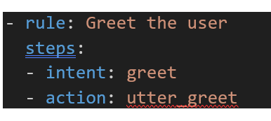
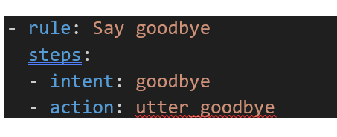
Greeting the User
Greeting the User
First interaction with greeting is not necessary for the stories it is implemented in the rules.
This is implemented, also, for the goodbye greet.
Notes:
The functionality for greeting the user involves specific rules and steps. The first interaction doesn't require a greeting in stories. The rule is implemented with the intent to greet and the action to utter_greet. Original Content: Functionality Greeting the user: First interaction with greeting is not necessary for the stories it is implemented in the rules. - rule: Greet the user steps: - intent: greet - action: utter_greet

Slide 9

Movie Recommendation Path
Ask
Ιntent: ask_movie_recommendation
Action
Action: movie_recommendation_form
Slot
Slot: release_year, movie_genre (e.g., "drama", “2008”)
Form
Form: movie_recommendation_form captures location details and stores them in the slots
Action
Action: action_recommend_movie
Notes:
The bot offers two recommendation paths: one for movies and one for series. For movies, it collects genre and release year preferences before making a recommendation. Similarly, for series, it gathers genre and release year preferences to provide a suggestion. Original Content: Description of scenarios 1st. Movie Recommendation Path: The user requests a movie recommendation, and the bot collects preferences (movie genre and release year) through the form before making a recommendation. 2nd. Series Recommendation Path: Similar to the movie path, but this time the user requests a series recommendation. The bot collects the series genre and release year and provides a suggestion accordingly.

Slide 10
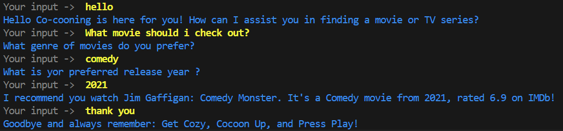
Movie Recommendation Path real dialog

Slide 11
Series Recommendation Path
Ask
Ιntent: ask_series_recommendation
Action
Action: series_recommendation_form
Slot
Slot: release_year, movie_genre (e.g., "drama", “2008”)
Form
Form: series_recommendation_form captures location details and stores them in the slots
Action
Action: action_recommend_series
Notes:
The bot offers two recommendation paths: one for movies and one for series. For movies, it collects genre and release year preferences before making a recommendation. Similarly, for series, it gathers genre and release year preferences to provide a suggestion. Original Content: Description of scenarios 1st. Movie Recommendation Path: The user requests a movie recommendation, and the bot collects preferences (movie genre and release year) through the form before making a recommendation. 2nd. Series Recommendation Path: Similar to the movie path, but this time the user requests a series recommendation. The bot collects the series genre and release year and provides a suggestion accordingly.

Slide 12

Series Recommendation Path real dialog

Slide 13
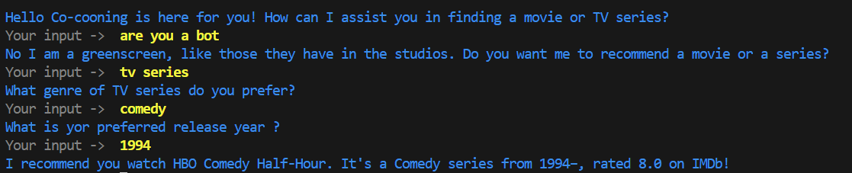
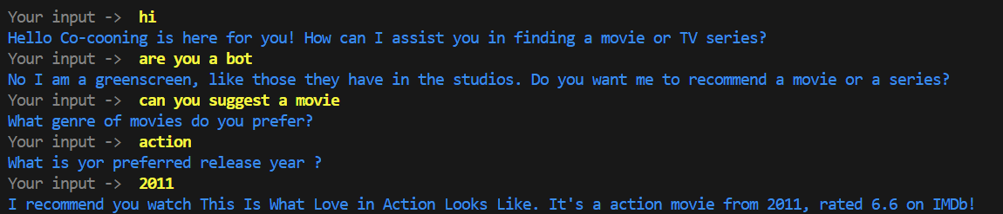
Sad Path with Series Recommendation & Sad Path with Movie Recommendationx
Notes:
In this scenario, the user challenges the bot, leading to a shift in the conversation towards series recommendations. The bot collects the necessary details and then makes a series suggestion. Original Content: 5th. Sad Path with Series Recommendation: Similar to the previous path, but the conversation shifts to asking for a series recommendation after the user challenges the bot. The bot collects the necessary series details and makes a suggestion.

Slide 14
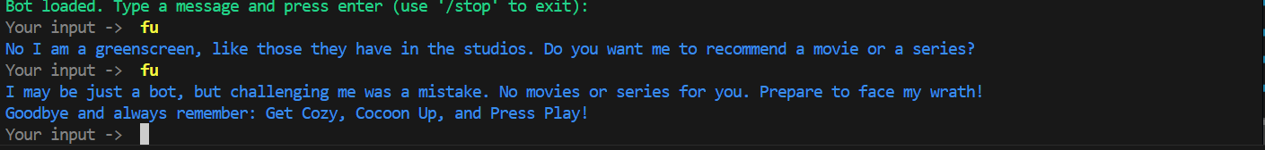
Sad Path with Rage
Without slots or forms involved
intent: bot_challenge
action: utter_bot_challenge_response
intent: bot_challenge
action: utter_rage
action: utter_goodbye
Notes:
In this scenario, the user challenges the bot, leading to an initial response. When the user persists, the bot escalates to a rage response and ends the conversation with a goodbye. Original Content: 3rd. Sad Path with Rage: This scenario handles cases where the user challenges the bot. After an initial response from the bot, the user persists with another challenge. The bot escalates to a "rage" response and then ends the conversation with a goodbye.

Slide 15

Forms
Movie Recommendation Form
Gathers information about the movie user wants to see
Uses two slots: release_year and movie_genre
Series Recommendation Form
Gathers information about the series user wants to see
Uses two slots: release_year and movie_genre
Notes:
We have two forms for recommendations: one for movies and one for series. Both forms gather information using two slots: release year and genre. Original Content: Forms movie_recommendation_form: It gathers information about the movie user want to see. It uses for that purpose two slots release_year, movie_genre series_recommendation_form: It gathers information about the series user want to see. It uses for that purpose two slots release_year, movie_genre

Slide 16
Policy
RulePolicy for Rule-Based Interactions
Handles activating forms
Guides structured flows
Ensures predictable behavior in straightforward scenarios
MemoizationPolicy for Consistent Responses
Remembers exact conversation patterns from training stories
Applies patterns to ensure consistency
Matches previously seen conversation paths
TEDPolicy for Flexibility
Uses machine learning to predict next action
Considers last five conversation turns
Trained over 100 epochs
Notes:
The Co-cooning bot uses RulePolicy for rule-based interactions, MemoizationPolicy for consistent responses, and TEDPolicy for flexibility. RulePolicy handles forms and structured flows, MemoizationPolicy remembers conversation patterns, and TEDPolicy predicts actions using machine learning. Original Content: The Co-cooning bot utilizes three key Rasa policies to manage conversations effectively. First, the RulePolicy is responsible for handling rule-based interactions, such as activating forms and guiding structured flows. This policy ensures the bot behaves predictably in straightforward scenarios. Next, the MemoizationPolicy remembers exact conversation patterns from the training stories, applying them to ensure consistent responses when the conversation matches previously seen paths. Finally, the TEDPolicy introduces flexibility by using machine learning to predict the next action based on the last five conversation turns. It is trained over 100 epochs and includes a constraint on similarities to help differentiate between similar intents and actions. Together, these policies enable the Co-cooning bot to smoothly handle both predictable interactions and more dynamic, unforeseen conversations.

Slide 17
Challenges
"Sad Path" Story Implementation: Implementing a "sad path" story with an utter rage response posed challenges due to contradictions between the defined stories and the chatbot's rules. Multiple scenarios were created to cover all possible outcomes and avoid looping.
.OMDb API Integration: Initially, various APIs were explored, but issues with privacy settings, costs, and personal information requests led to selecting the OMDb API. However, its limit of 1,000 calls per day remains a constraint.
Policy and Debugging Issues: Generic error messages made it difficult to identify the specific causes of errors during debugging, complicating the troubleshooting process.

Slide 18
Real World Data Sources
Purpose of the Chatbot
Help users quickly choose a movie or series
Avoid overwhelming users with too many options
Practical Considerations
Affordability and straightforward integration
OMDb API chosen for its essential data
Benefits of OMDb API
Provides genre and release year
Enables quick and relevant recommendations
Maintains a relaxed user experience
Overall Approach
Ensures decision-making is easy, enjoyable, and efficient
Notes:
The Co-cooning chatbot uses the OMDb API for its affordability and ease of integration. This helps users quickly choose movies or series by providing essential data like genre and release year, ensuring a relaxed and efficient decision-making process. Original Content: Real world data The choice of real-world data sources for Co-cooning was shaped by the chatbot’s purpose and practical considerations. The goal is to help users quickly choose a movie or series without overwhelming them with too many options or complicated interactions. To align with this philosophy, I opted for the OMDb API for its affordability and straightforward integration. OMDb provides essential data—such as genre and release year—enabling quick and relevant recommendations while maintaining a relaxed user experience. This approach ensures that decision-making remains easy, enjoyable, and efficient.

Slide 19

Further Steps
Gather more user preferences
Ask users about their favorite movies or series
Enhance recommendations based on user input
Capture specific likes
Include options for users to specify favorite actors
Allow users to select preferred directors
Provide choices for favorite genres
Improve personalization
Use collected data to tailor suggestions
Match recommendations more closely to individual tastes
Notes:
To enhance recommendations, gather more user preferences by asking about favorite movies or series. Capture specific likes by allowing users to specify favorite actors, directors, or genres. Use this data to improve personalization and tailor suggestions to individual tastes. Original Content: Further Steps Gather more user preferences: Ask users about their favorite movies or series to enhance recommendations. Capture specific likes: Include options for users to specify favorite actors, directors, or genres. Improve personalization: Use collected data to tailor suggestions more closely to individual tastes.

Slide 20
Sources
Github Repository for Public APIs
Link: https://github.com/public-apis/public-apis
Rasa Tutorial
YouTube Link: https://www.youtube.com/watch?v=Ap62n_YAVZ8&ab_channel=Rasa
Rasa Documentation
Link: https://rasa.com/docs/rasa/
CoPilot M365 & GPT 4
Use CoPilot as an assistant with the code
Notes:
Here are some useful sources for development and documentation: a Github repository for public APIs, a Rasa tutorial on YouTube, Rasa documentation, and CoPilot M365 & GPT 4 for code assistance. Original Content: Sources Github repository for public API’S. Link: https://github.com/public-apis/public-apis Rasa Tutorial (YouTubeLink: https://www.youtube.com/watch?v=Ap62n_YAVZ8&ab_channel=Rasa Rasa Documentation. Link: https://rasa.com/docs/rasa/ CoPilot M365 & GPT 4 (use copilot as assistant with the code)

